Slide 1
Project Module 2
What is the impact oF freedom (movement, choice) on happiness?
20.11.2020

Slide 2
Introduction
World Happiness Report
Happiness score
Freedom of choice score
Human Freedom report
Domestic freedom of movement
Foreign freedom of movement
Notes:
Since the Covid-19 situation, it is well known that the several lockdowns have restricted our freedom of movement and freedom of choice. Indeed, without this situation without precendent, I could have made the choice to move to Amsterdam. You could have all physically attend the presentation I am currently doing and then we would have grabbed a beer to celebrate the end of the presentations. I don't know what do you think about it but this would have made me happier than being behind a screen.
That is why I had the idea Ito analyze what what is the impact on freedom restrictions on happiness.
The data that were used for this analysis are thus The World Happiness Report including the happiness score and freedom of choice scores per country along with the Human Freedom report overviewing the domestic and foreign freedom of movement scores. The main challenge here was thus to merge these two data bases mainly including types of data related issures. Cleaning the data was thus a complicated task. I will share one of my main discovery to help you with modifying several data types at the end of the presentation.

Slide 3
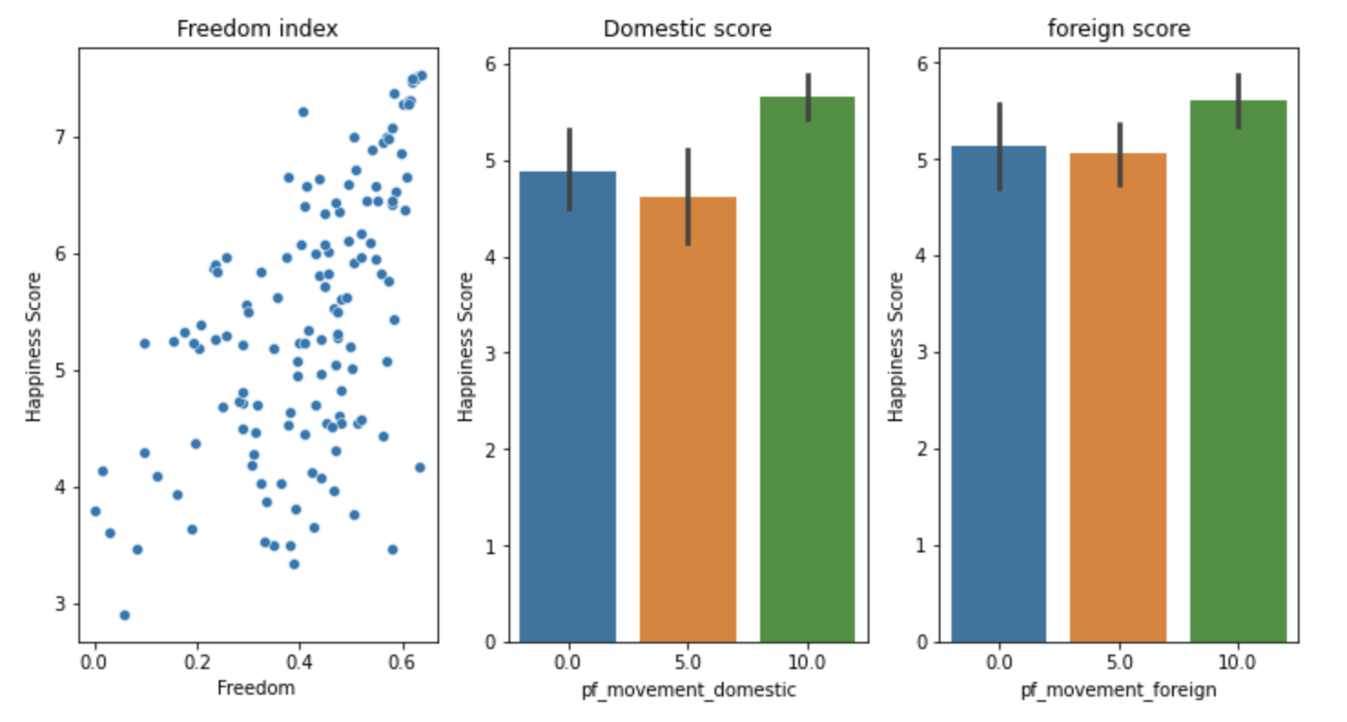
Correlation between the Happiness score per country and Freedom indexes
Notes:
Once the data cleaned, I've started the analysis by overviewing the relation with the happiness score and the freedom indexes.
1) I will start with the relation between Freedom of choice & Happiness.
The freedom choice data represents the possibility to make life choices score per country. It is the national average of binary responses to the question “Are you satisfied or dissatisfied with your freedom to choose what you do with your life?" We see on the scatter plot graph that the higher the Happiness score is, the freer the inhabitants of a country are.
Thus, when the freedom score is higher, the Happiness score will tend to be high too.
### Freedom of movement index & Happiness score relation for 2017
The domestic and foreign freedom of movement data indicates respectively the score representing the possibility to freely move within a country or outside a country. 0 representing the least free countries and 10, the freer countries.
The result here is intriguing because we see that countries with a score of 0 have an average happiness score of higher than countries with a score of 5.
This goes against the primary hypothesis that freedom (and in this case domestic freedom) is a key element to global happiness. Although, this could be explained by the fact that, people living in countries with a very restricted freedom of movement may not be able to clearly see what they are missing by not having the possibility to freely move within or outside their country.
This hypothesis is strengthened by the fact that the countries with a domestic or foreign freedom score of 10 tends to have a high happiness score.

Slide 4
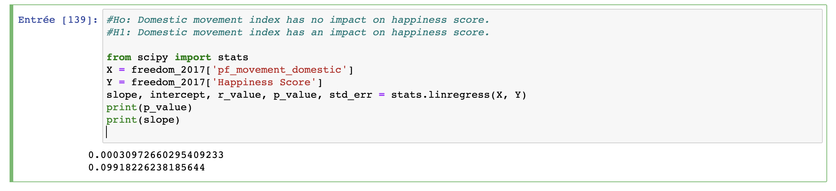
Hypothesis testing
Notes:
This was also a good opportunity to check the impact of the freedom of movement on the happiness score by analyzing the slope and the p-value of the relation between the freedom of movement and the happiness score. In instance, I used the domestic freedom of movement.
By using the function stats.linregress, I’ve noticed that the slope of the linear regression graph is 10%. This means that the impact is quite low as the line I almost flat.
Although the p-value is close to zero which that the H0 hypothesis should be rejected, thus the Domestic movement index has an impact on happiness score.

Slide 5
Correlation between the Happiness score per country and Freedom indexes
Notes:
From this analysis, we can conclude that the freedom of choice and freedom of movement have an impact on happiness.
We ser that the Freedom index has the highest correlation with the Happiness score. It thus makes sense to analyses this further.

Slide 6
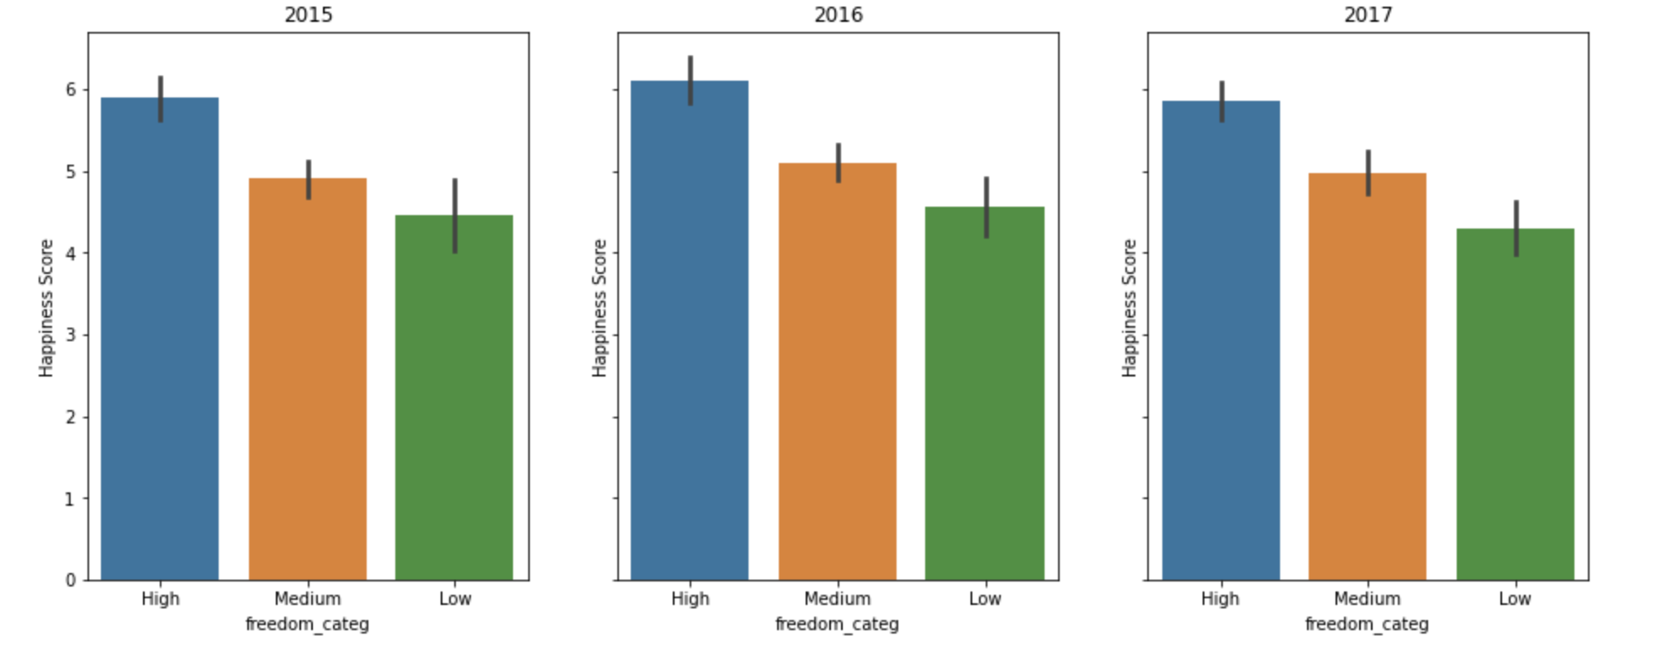
Futher Analysis: Freedom index & Happiness.Score relation from 2015 to 2017
Notes:
I’ve divided the freedom of choice within three categories: Low, High and Medium.
We see that the trends are very similar for these 3 years, the average for the countries with a wide freedom is close to 6 for the three graphs.
Except for 2016 where the countries included in the Highest freedom category obtained a slightly better score.

Slide 7
Further analysis per countries using Tableau

Slide 8
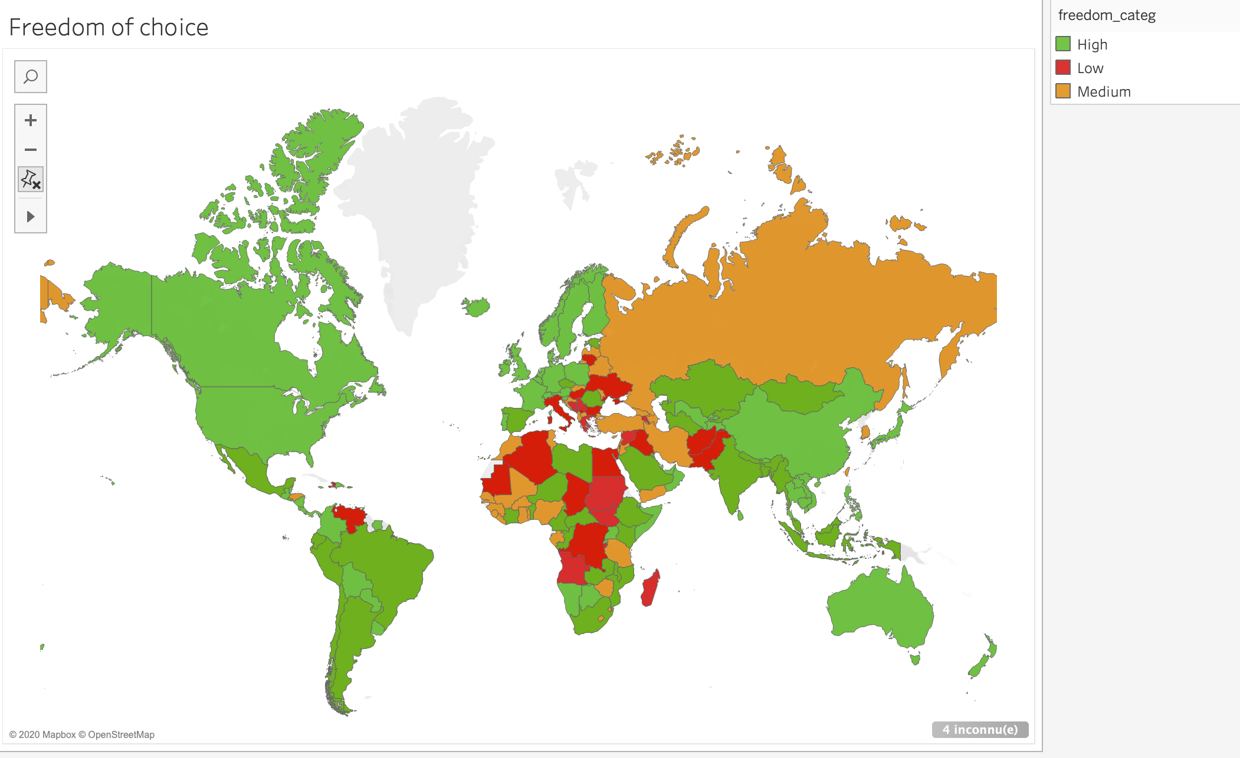
Further analysis per countries
Notes:
## Countries with a "low" Freedom score : 12%
## Countries with a "medium" Freedom score : 36%
## Countries with a "high" Freedom score : 52%
North Korea

Slide 9
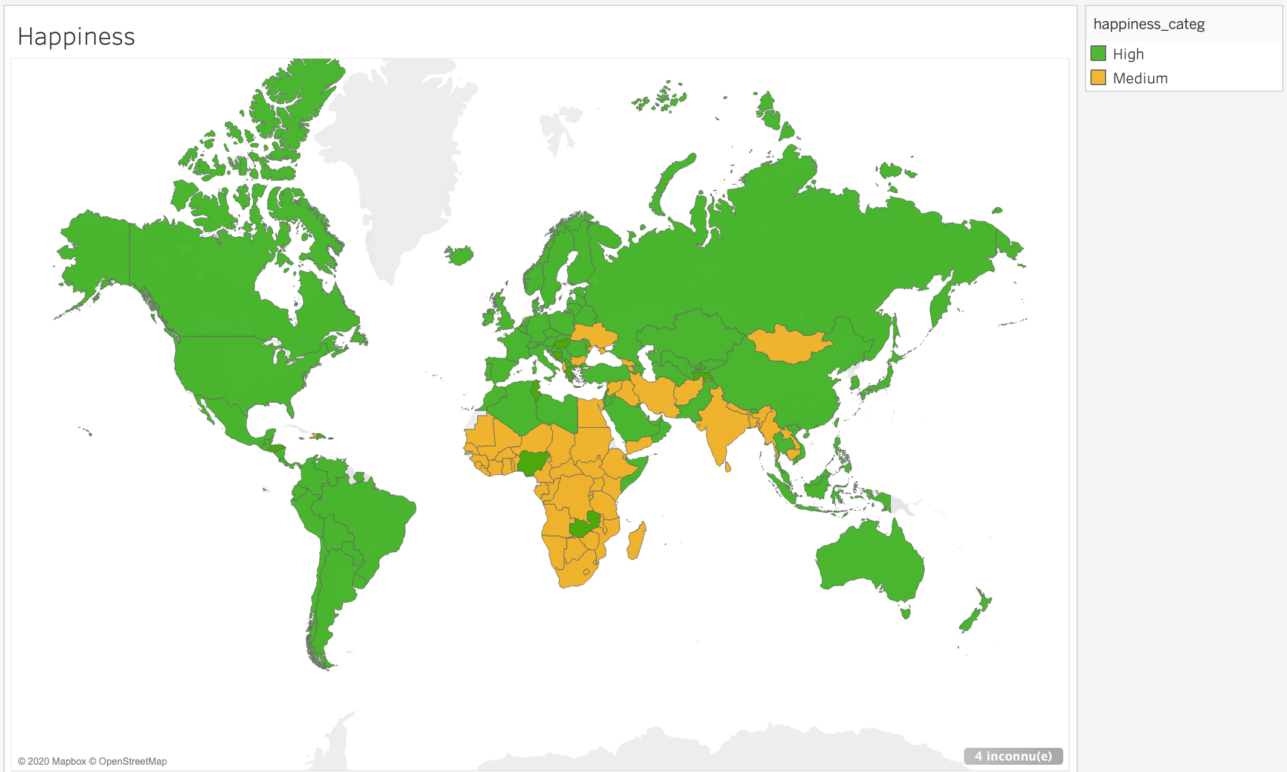
Notes:
## Countries with a "low" Happiness score : 0, lowest score is above 2,16.
## Countries with a "Medium" Happiness score : 37%
## Countries with a "Medium" Happiness score : 63%

Slide 10
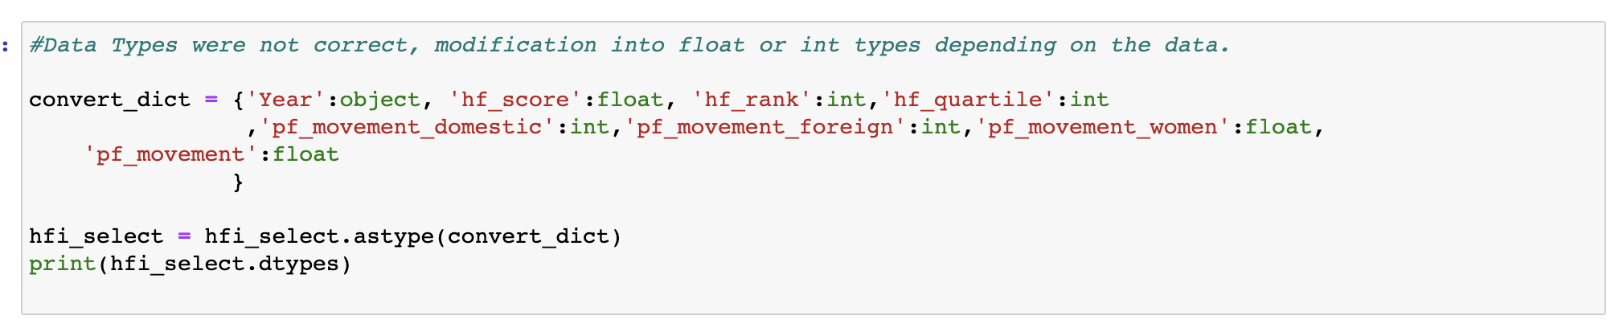
Sharing is caring

Slide 11
Questions?

